Slide 1
Video Viral Advertisement: Is Sharing enough for Brands?
Dra. Flavia Braga Chinelato - CENTRUM PUCP, Peru
Dr. Cid Gonçalves Filho - Universidade FUMEC, Brazil
Ms. Daniel Randt - Universidade FUMEC, Brazil

Slide 2
- YouTube alone is responsible for over 1 billion hours of video views daily (Duffet, 2022).
- 64% of consumers buy products after watching videos about the brand on social media.
- Companies increase their revenues by 49% when they use commercial videos (Lister, 2018).

Slide 3
So, the mainstream of previous research is oriented to reveal the properties of video ads that lead to sharing, but not how they affect the brand.
Therefore, a paradox could emerge. We can have very successful video sharing that can enhance the brand, have no impact, or even destroy it (as it becomes more shared), a finding that could reveal a Brand-Share Paradox of viral marketing.
Context
The most relevant objective of an ad is to impact the brand positively.

Slide 4
1- to empirically demonstrate the impact of value drivers of video ads on sharing;
Objectives
2- to identify the influence of these value drivers on advertiser's brand equity;
3-compare the effects on both constructs and analyse how differences and similarities could reveal the relevance of branding-sharing alignment in viral marketing.
1- to empirically demonstrate the impact of value drivers of video ads on sharing;

Slide 5
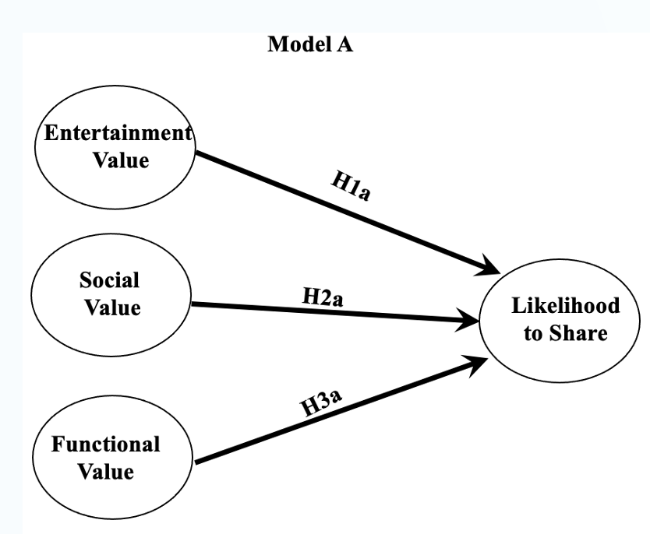
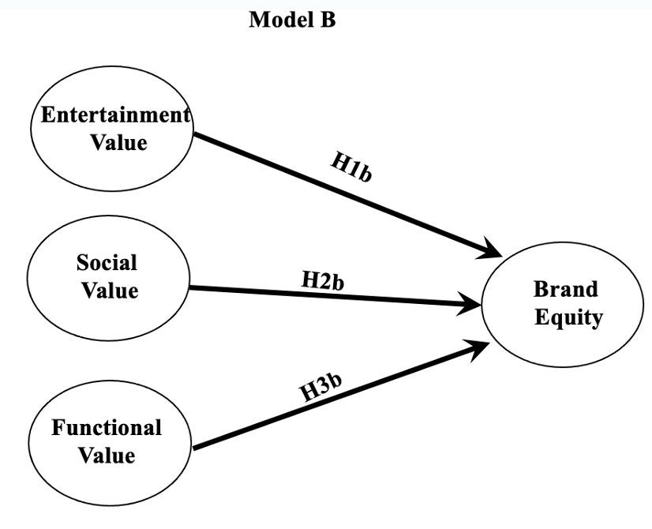
Hypothetical Model

Slide 6
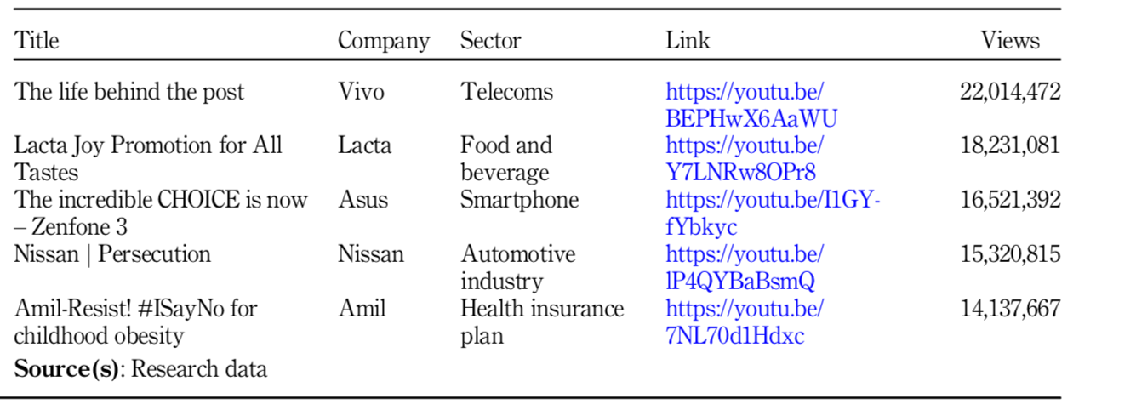
Methodology
A survey:
368 university students.
5 commercial videos from Youtube Brazil - big companies.

Slide 7
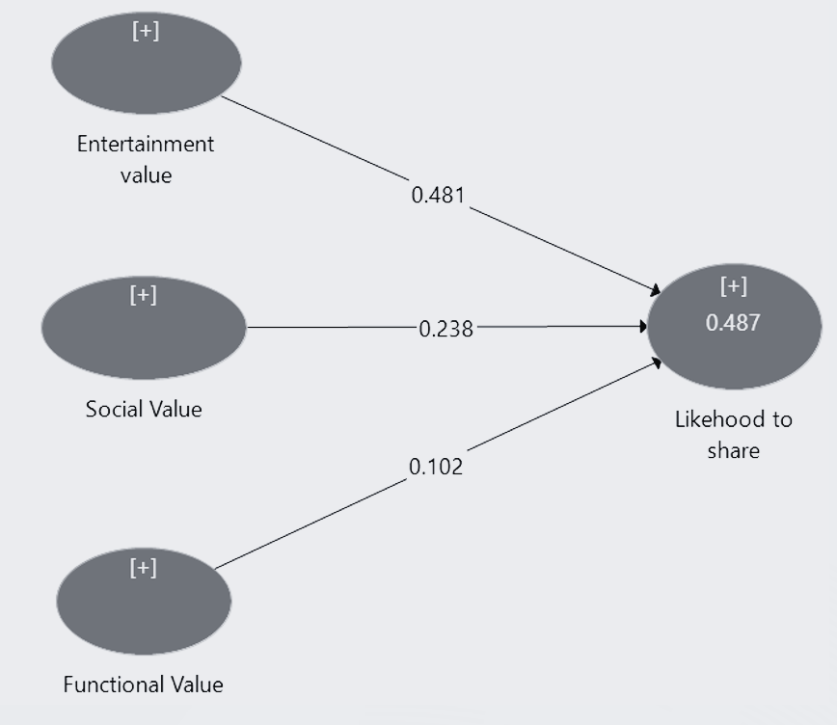
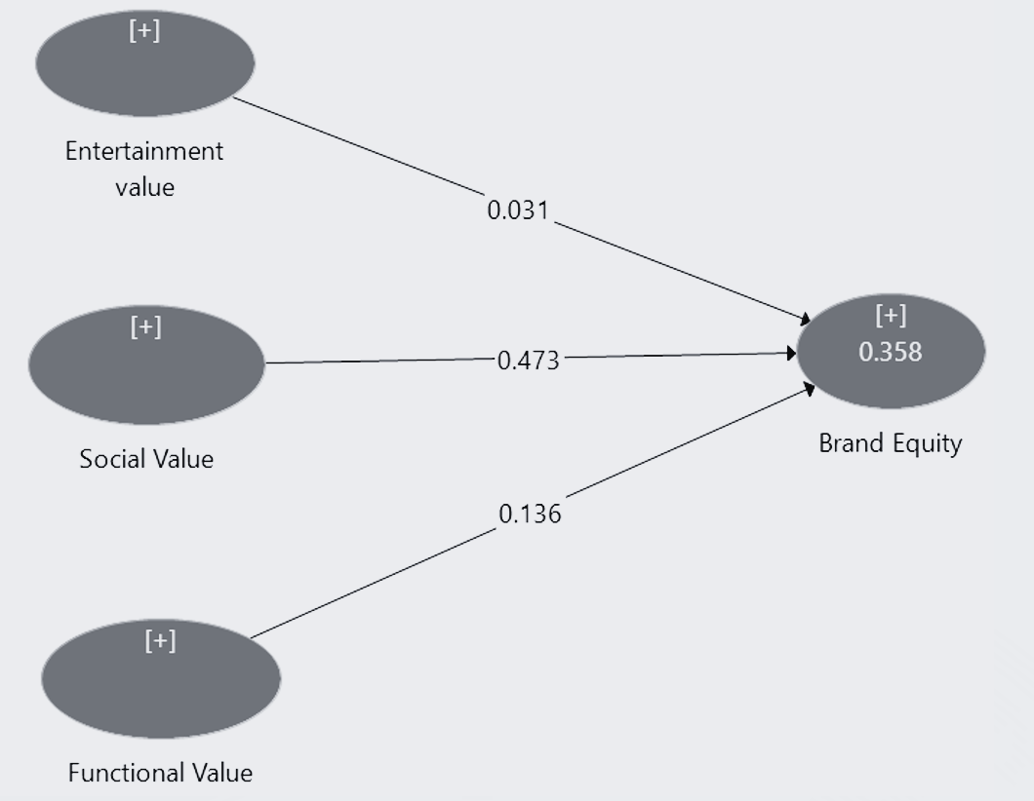
Results
Model A
Model B

Slide 8
The Brand Share-Matrix

Slide 9
Thank you!
Dra. Flavia Chinelato
fchinelato@pucp.edu.pe
Dr. Cid Gonçalves Filho
cid@fumec.br

